Slide 1
TOXICOLOGY
Intoxications: Symptoms & Therapy
Prof. RNDr. Zdeněk DVOŘÁK, DrSc., Ph.D.
Department of Cell Biology & Genetics
Faculty of Science, Palacky University Olomouc

Slide 2
DOSE
Philippus Aureolus Theophrastus Bombastus von Hohenheim (Paracelsus) – Swiss-German philosopher, physician, botanist, astrologer, founder of toxicology (1493-1541)
„The dose makes the poison"
„Sola dosis facit venenum“
„Alle Dinge sind Gift und nichts ist ohne Gift, allein die Dosis macht es, dass ein Ding kein Gift ist.“
CLASSIFICATION
Accidental
Household products (cleaning, dyes, solvents, anti-cough drugs, paracetamol)
Food-born (adulterants, illicit drugs, toxins)
Inhalation (petroleum products, solvents – dyes, nailpolish, diesel exhausts)
Industrial and environmental accidents, natural disasters
Intentional
Suicidal
Homicidal
Drug and alcohol abuse

Slide 3
SYMPTOMS
Non-specific
Acute disorders of consciousness, abnormal behaviour, coma, spasms, shock, respiratory distress, cardiac rhytm alterations, metabolic acidosis, diarrhoea, profuse vomiting
Odours
Bitter almonds = cyanide
Acetone = methanol, acetylsalicylic acid
Garlic = organophosphates, arsenic, phosphorus
Alcohol = ethanol, methanol
Oil = kerosens
Skin
Cyanosis non-responsive to oxygen = nitrites, nitrates, phenacetin, benzocain
Erythem = CO, cyanide, anticholinergics
Dry skin = anticholinergics
Sweating = amphetamines, LSD, barbiturates, cocain, organophospates
Icterus = paracetamol, mashrooms, Fe, phosphorus
Blood pressure
Hypertensis = sympathomimetics, amphetamine, organophosphates
Hypotensis = narcotics, sedatives, hypnotics, β-blockers, Ca-channel blockers, TCAs

Slide 4
SYMPTOMS
Heart rate (pulse)
Bradycardia = digitalis, hypnotics, β-blockers, Ca-channel blockers
Tachycardia = sympathomimetics, amphetamine, TCAs, cocain, alcohol, anticholinergics
Cardiac arrhythmia
Supraventricular tachycardia = TCAs, anticholinergics
Atrial tachycardia = digitalis, TCAs, cocain
Generally = β-blockers, Ca-channel blockers, organophosphates
Mucosa
Dry = anticholinergics
Hypersalivation = organophosphates, carbamates
Lesis = acids, alkaline hydroxides
Respiration
Depression = alcohol, narcotics, barbiturates, sedatives, hypnotics
Tachypnea = salicylates, amphetamine, CO
Pulmonary edema = organophospates
Pneumonia = hydrocarbons, kerosens
Wheezing = organophosphates
Kussmaul breathing = salicylates, methanol, ethylene glycol

Slide 5
SYMPTOMS
CNS
Spasms = TCAs, cocain, phenothiazines, amphetamines, salicylates, organophosphates
Miosis = narcotics, phenothiazines, barbiturates, organophosphates, mushrooms
Mydriasis = anticholinergics, sympathomimetics, cocain, TCAs, LSD, methanol
Nystagmus = barbiturates, carbamazepine, alcohol, hidantoines
Delirium/psychosis = anticholinergics, sympathomimetics, alcohol phenothiazines, LSD, cocain, heroin, heavy metals
Coma = alcohols, anticholinergics, narcotics, sedatives, hypnotics, CO, salicylates
Faintness/paralysis = organophosphates, carbamates, heavy metals
GIT
diarrhoea, vomiting = Fe, phosphorus, heavy metals, lithium, mushrooms, organophosphates

Slide 6
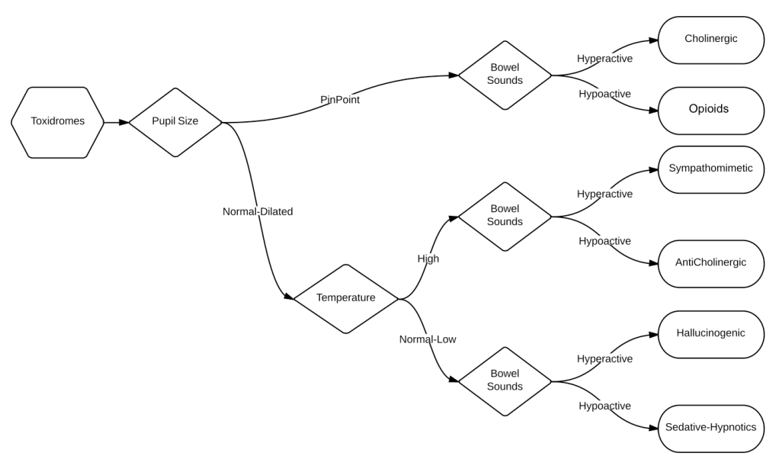
TOXIDROME
Toxic + Syndrome
symptoms | Blood pressure | Heart rate | Respiratory rate | Temperature | Pupil size | Bowel sounds | Diaphoresis (sweating)
Anticholinergic | ~ | ↑ | ~ | ↑ | ↑ | ↓ | ↓
Cholinergic | ~ | ~ | ~ | ~ | ↓ | ↑ | ↑
Hallucinogenic | ↑ | ↑ | ↑ | ~ | ↑ | ↑ | ~
Sympathomimetic | ↑ | ↑ | ↑ | ↑ | ↑ | ↑ | ↑
Sedative-hypnotic | ↓ | ↓ | ↓ | ↓ | ~ | ↓ | ↓

Slide 7
IDENTIFICATION OF NOXAE
Laboratory analyses – urine, blood, stomach content, (ev. faeces – mushrooms)
Examination/inspection of the scene – drug or household containers….
MANAGEMENT/THERAPY
Maintenance of vital functions
Antidotes
Elimination of noxae

Slide 8
ANTIDOTES
Only small number of poissons/drugs have appropriate antidote
Mostly receptor antagonists or enzyme competitors
ANTIDOTE INDICATION
ATROPINE organophosphates, carbamates, nerve agents, mushrooms
β-BLOCKERS theophylline
CALCIUM Ca-channel blockers
CHELATORS (EDTA, BAL) heavy metals
AMYL NITRITE cyanide
DEFEROXAMINE iron
ANTIBODIES digoxin, snake venom
ETHANOL ethylene glycol, methanol
FLUMAZENIL benzodiazepines
NALOXONE opiates
N-ACETYLCYSTEINE paracetamol
PHYSOSTIGMINE anticholinergic drugs

Slide 9
ELIMINATION OF NOXAE
Irrigation (lavage) – stomach, whole bowel
Activated charcoal – not effective for strong acids and alkali, solvents, Fe, Li, As
Hemodialysis – semipermeable membrane; extracorporeal device = salicylates, acetone, aniline, barbiturates, alcohols, toluen
Hemoperfusion – extracorporeal device; blood passes column with sorbent (active charcoal, resins) = small to medium-sized molecules that are difficult to remove by hemodialysis; e.g. TCAs, chloropromazine, paracetamol, theophyllin, barbiturates
Forced diuresis: *most of drugs are weak acids or bases
*when urine is alkaline, elimination of acidic drugs is increased
*when urine is acidic, elimination of alkaline drugs is increased
*adjustment of pH of plasma/urine by infusion, according to pK of drug
forced alkaline diuresis – pH ↑ bicarbonate = salicylates, barbiturates (acidic drugs)
forced acidic diuresis – pH ↓ ascorbate, NH₄Cl = cocaine, quinidine, strychnine (alkaline d.)

