Slide 1
TOXICOLOGY
Nuclear Receptor-Mediated Toxicity
Prof. RNDr. Zdeněk DVOŘÁK, DrSc., Ph.D.
Department of Cell Biology & Genetics
Faculty of Science, Palacky University Olomouc

Slide 2
Evidence for Nuclear Receptor-Mediated Toxicity:
Tissue specific effect
Predictable effect
Transactivation of specific genes is increased
Rapid transcriptional response
Reversible binding of compound to intracellular molecules
Stereospecific effects
Molecular Properties of Nuclear Receptors:
Soluble (intra-cellular) receptor that binds a ligand, migrates to cell nucleus and interacts with specific genomic response elements
No second messengers in NR signalling
Effector is DNA
STEROID/THYROID/RETINOID FAMILY
PAS (Per/ARNT/Sim) FAMILY
Steroid receptors (ER, PR, AR, GR, MR)
Vitamin D Receptor (VDR)
Retinoid Receptors (RARs, RXRs)
Peroxisome proliferator-activated r. (PPARs)
AhR = Aryl Hydrocarbon Receptor
ARNT = AhR Nuclear Translocator
HIF1α = Hypoxia-Inducible Factor

Slide 3
STRUCTURE OF NUCLEAR RECEPTORS
dimerization domains
A/B
C
D
E
F
NH₂
COOH
AF1
N-terminal domain
activation function
ligand independent
AF2
activation function
ligand dependent
LIGAND BINDING DOMAIN
HINGE
C-terminal domain
variable
DNA BINDING DOMAIN

Slide 4
ARYL HYDROCARBON RECEPTOR
dioxin receptor
ubiquitously expressed (lung, thymus, placenta, liver, kidney, heart, spleen)
ligand-(in)dependent activation
ligands/activators:
NATURAL (flavonoids, isoflavones, stilbenes, anthocyans)
DRUGS (omeprazole, lansoprazole, primaquine, ketoconazole)
CHEMICALS (SP600125, U0126)
ENDOGENOUS (indoles)
ENVIRONMENTAL POLLUTANTS (PCBs, PAHs….)
target genes – CYP1A1, CYP1A2, CYP1B1, phase II enzymes
AHRR = AhR repressor – forms AHRR/ARNT heterodimer, which binds to XRE but does not trigger gene expression
AHRR is up-regulated by AhR = negative regulatory feed-back
L
DRE = dioxin-responsive element
XRE = xenobiotic-responsive element
AHRE = AhR responsive element
AhR
ARNT
DRE
core sequence 5’-GCGTG-3’
consensus sequence 5’-T/GNGCGTGA/CG/CA-3’

Slide 5
AhR SIGNALLING
L
L
L
XAP2
L
L
hsp90
L
L
AhR
p23
L
L
hsp90
ARNT
L
L
AhR
XAP2
XAP2
L
hsp90
AhR
ARNT
L
hsp90
AhR
p23
p23
CYP1A1
DRE
hsp90
hsp90

Slide 6
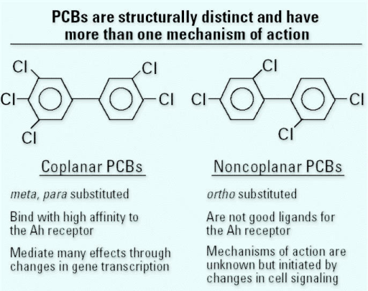
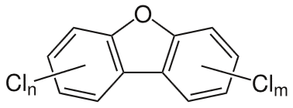
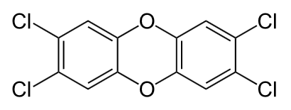
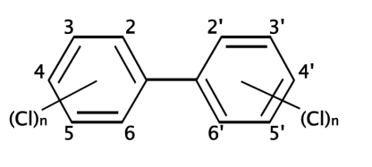
AHR-MEDIATED TOXICITY
AhR binds many polychlorinated aromatic compounds with differing affinity
pleiotropic toxicological effects; multitude transcriptional and phenotypic effests
PCDDs, PCDFs, PCBs = the most toxic environmental chemicals
highly lipophilic persistent compounds = long biological t_{½} (7 – 11 years!)
different degree of chlorination = many congeners; variable toxic potential
often mixtures → relative measure of toxicity = TOXICITY EQUIVALENTS (T.E.)
T.E.s calculated for the most potent congener TCDD; T.E. = 1.0
relative toxic potential of PCBs, PCDDs and PCDFs correlates with their affinity to AHR
binding to AHR is optimal when ligand is coplanar
polychlorinated dibenzodioxins
PCDDs (75 congeners)
polychlorinated dibenzofurans
PCDFs (75 congeners)
2,3,7,8,-tetrachloro-p-dibenzodioxin
TCDD
polychlorinated biphenyls
PCBs (209 congeners)
Ganey PE, Boyd SA (2005) An approach to evaluation of the effect of bioremediation on biological activity of environmental contaminants: dechlorination of polychlorinated biphenyls. Environ Health Perspect. 113(2):180-5

Slide 7
AHR-MEDIATED TOXICITY - TCDD
environmental pollutant with a very high toxic potential featuring pleiotropic activity
immunotoxicity, endocrine toxicity, embryotoxicity, teratogenesis (in aminals)
human carcinogen Class 1 via non-genomic mechanisms
acute toxicity = maximal effects after 2-4 weeks after single exposure
species-specific sensitivity; e.g. guinea pigs (LD₅₀ 500 ng/kg) vs hamster (LD₅₀ 5 mg/kg)
in humans – chloracne = persistent disturbance of epithelial cells differentiation in skin
high affinity of TCDD to AHR ( K_{d} = 10⁻¹¹ M) – species-specific(!)
TCDD-activated AHR triggers transcriptional response of many
genes, but one single „toxicity gene“ dysregulated by AHR is unlikely
Evidence for AHR-mediated toxicity of TCDD:
Responsiveness to TCDD positively correlates and segregates with Ah^{b-l} allele
The Kd for TCDD of nonsensitive mouse strains is 10-20 x higher than of sensitive ones
AHR-null mice are resistant against toxic effects of TCDD

Slide 8
AHR-MEDIATED TOXICITY – TCDD&CANCER
mechanism is probably combined, involving disruption of cell cycle and oxidant stress
TCDD alters transcription factors (E2F) and cyclin-dependent kinases inhibitors (p27^{kip1}), resulting in CELL CYCLE DISRUPTION
TCDD induces extensive OXIDANT STRESS by induction of CYP1A1/2 and in mitochondria by interfering with electron transport chain (oxidation of SH- groups, increase of Ca²⁺, ROS production, DNA damage)
ROS production in mitochondria is low in AHR-knock-out mice = mitochondrial oxidant stress depends rather on AHR than on CYP1A1/2
CYP1A1/2
OXIDATIVE STRESS
TCDD
AHR
mitochondria
CANCER
P27^{kip1}; E2F
CELL CYCLE DISRUPTION
TRICLOSAN
antifungal, antibacterial
tooth pastes, soaps, deodorants
gets to environment where it undergoes photochemical degradation to 2,8-DCDD

Slide 9
ESTROGEN RECEPTOR - ER
exists in two forms ERα and ERβ – distinct proteins differing in transcriptional activity
tissue-specific expression
forms homodimers ERα/ERα and ERβ/ERβ
ERα form preferentially heterodimer ERα/Erβ
ER binds large variety of chemically unrelated
compounds = „promiscuity“
L
L
ER
ER
ERE
Estrogen Response Element – ERE
XENOESTROGENS = environmental estrogens
xenobiotics that can elicit agonistic (enhancing) response mediated by ER
responsible for hormonally-controlled cancers (mammary, testicular, prostate)
interfere with normal reproduction in wildlife
DDT, hydroxy-PCBc, alkylphenols, bisphenol A, diethylstilbestrol (anti-abortive)
complicated risk assessment
A) xenoestrogens are usually weak ER agonists, i.e. they have low relative estrogenic potency as compared to endogenous estrogens = rather high concentrations of xenoestrogens are required to elicit adverse effect
B) environmental stability, bioaccumulation, high lipophilicity = increased danger

Slide 10
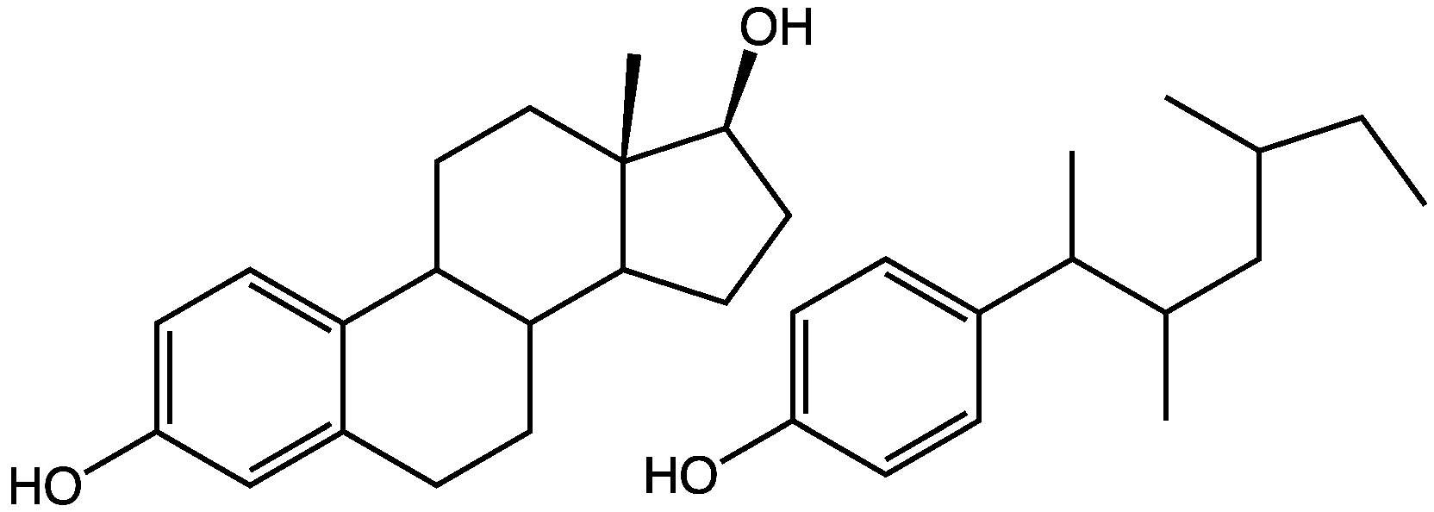
ER-MEDIATED TOXICITY: ALKYLPHENOLS
alkylphenol ethoxylates – industrial and household use – detergents, emulsifiers
massive commercial production – nonionic surfactants, stabilizers in plastics…
bacterial degradation to alkylphenols
alkylphenols - very low acute toxicity vs accumulation in organisms and sediments
- estrogenic activity !!!
the most known p-nonylphenol (PNP)
PNP binds to and activates ER
transactivation of estrogen-responsive genes
Risk of PNP is low or high?
PNP has 30.000x lower affinity to ER than E2
PNP is inactivated by glucuronidation
PNP does not cross placental barrier
PNP accumulates in fat tissue → upon sudden weight loss, PNP can be mobilized from adipose tissue and plasma levels can reach 10 x of those before fasting
risk assessment must be very complex
estradiol
p-nonylphenol

Slide 11
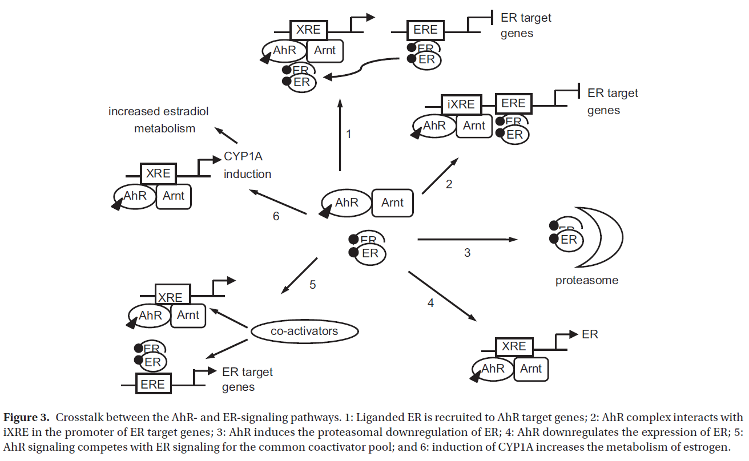
ER-MEDIATED TOXICITY: ER&AHR
cross-talk between nuclear receptors, e.g. ER vs AHR
biphasic effects of TCDD on ER: positive and negative
Monostory K., Pascussi J.M., Kobori L., Dvorak Z. (2009) Hormonal regulation of CYP1A expression. Drug Metab Rev 41(4):547-572.

Slide 12
ANDROGEN RECEPTOR - AR
pivotal role in development of male gonadal tissues
implicated in development of tumors (prostate cancer)
present in most tissues; abundand in male reproductive
organs; low levels in female reproductive organs
endogenous ligands – testosterone, DHT
xenobiotics causing endocrine-disruption through
AR = ANTIANDROGENS (e.g. Vinclozolin, DDT)
DDT = massively used pesticide in the past; DDE = breakdown product of DDT
DDE = antiandrogen, persistent, lipophilic, widespread in environment
DDE blocks AR functions in multiple ways: ↓ AR interaction with coactivators
↓ androgen binding with AR
↓ AR nuclear translocation → ↓ DNA binding
Some xenobiotics are dual ECD: XENOESTROGENS and ANTIANDROGENS
e.g. bisphenol A, p-nonylphenol
L
L
AR
AR
ARE
Androgen Response Element – ARE
p,p´-DDT
p,p´-DDE

Slide 13
PEROXISOME PROLIFERATOR-ACTIVATED
RECEPTOR - PPAR
PPARs – endogenous ligands: fatty acids and eicosanoids+metabolites
subtypes: PPARα, PPARβ (= PPARδ), PPARγ → different tissue distribution and function
name PPAR – historic reasons = ligands for PPAR caused proliferation of peroxisomes in rodents ; but in humans it is not true; better „fatty acid-activated receptor“
peroxisomes = subcellular organelles that function
as sites of fatty acyl-β-oxidation, cholesterol metabolism
glycerolipid synthesis and other lipids pathways
peroxisome proliferators = chemically diverse compounds
(clofibrate, ciprofibrate, gemfibrozil, nafenodipin, plasticizers – phtalates, solvents
PPs induce proliferation of peroxisomes and cause liver tumors in rodents
the common for PPs is that they are ligands for PPARs = chicken&egg problem
all subtypes of PPAR form heterodimer with RXR
L
PPAR
RXR
PPAR-RE

Slide 14
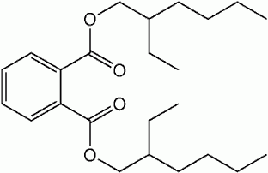
PPARα-MEDIATED TOXICITY
PPARα – ligands/activators cause hepatocarcinogenesis
PPs stimulate replicative DNA synthesis and liver growth = tumor-promoting characteristics
PPs inhibit hepatocyte apoptosis in vivo and in vitro → tumor-promotion
involvement of tumor necrosis factor beta (TNFβ) → it suppresses apoptosis and stimulates DNA syntesis in hepatocytes
role for mitogen-activated protein kinases (MAPKs; p38) → activated by oxidative stress
PPs increase fatty acyl-β-oxidation (in rodents not in man) → increased production of H₂O₂ → Reactive Oxygen Species = oxidant stress
sustained oxidative stress leads to nongenotoxic liver carcinogenesis
demonstrated in rodents not in man = perhaps irrelevant mechanism in man?
PPARα
activation
fatty acid
β−oxidation
ROS
oxidative stress
DNA replication
Cell growth
Inhibition of apoptosis
DEHP; diethyl hexyl phtalate
TNFβ
MAPK
+
initiation
(genotoxicity)
promotion
tumor
progression

Slide 15
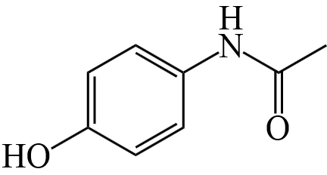
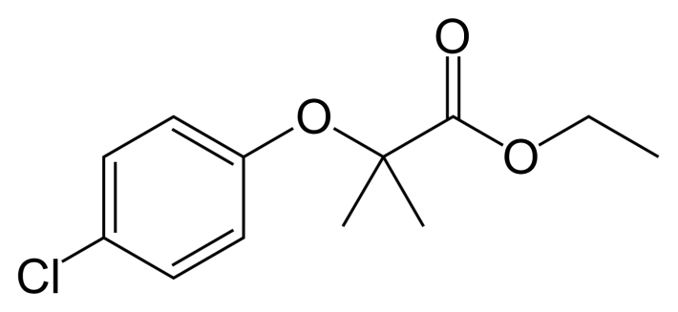
PPARα-MEDIATED TOXICITY
PPARα interestingly participates in cytoprotection against chemically different and mechanistically distinct hepatotoxicants
clofibrate (hypolipidemic drug – class „fibrates“) has hepatoprotective effect against liver injury induced by acetaminophen APAP, carbon tetrachloride, bromobenzene, chloroform
mechanism of protection is unrelated to mechanism of liver injury
PPARα−null mice had lost the ability to be resistant against APAP when given clofibrate; they also showed impaired liver regeneration after partial hepatectomy
PPARα controls growth regulatory genes (c-Ha-ras, fos, jun, egr-1) that are involved in the progression of cell cycle (G₀ → S transition)
the mechanism of PPARα-mediated hepatoprotection may involve stimulation of mitogenic response → increased hepatocellular proliferation → regeneration
clofibrate
acetaminophen (paracetamol)

Slide 16
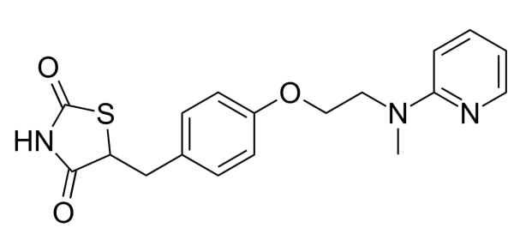
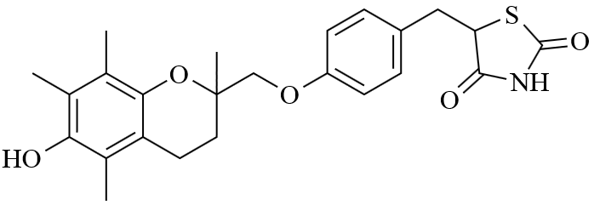
PPARγ-MEDIATED TOXICITY
PPARγ – “opposing receptor“ = mediates biological functions opposite to those by PPARα
antitumor effects, increase the storage of lipids
PPARγ – encoded by single gene, highly conserved structure in mice, rats, humans
alternative promotor use and alternative splicing = PPARγ1, PPARγ2, PPARγ2
two forms of proteins identified: PPARγ1, PPARγ2 → distinct tissue distribution
extra-adipose tissues (PPARγ1) vs adipose tissue (PPARγ2; 10-100x more)
expression of PPARγ is influenced epigenetically (↑nutrition, ↑obesity, ↑type II diabetes)
activation of PPARγ drastically differs under normal and pathophysiological conditions!
several drugs (e.g. thiazolidinediones, TZD) are ligands for PPARγ
TZD can induce fat accumulation in the bone marrow → anemia
TZD cause fatty changes in mice liver – enlargement of liver, microvesicular steatosis
occured only in obese mice with type II diabetes!! – extrapolation to humans??
rosiglitazone
troglitazone

Slide 17
PPARγ-MEDIATED TOXICITY
TZD→ increased transcription of adipocyte-specific PPARγ−regulated genes in bone marrow stromal cells
OBESE mice have highly up-regulated expression of PPARγ in liver
TZD induced transcription of genes involved in lipid metabolism (fatty acid-binding protein, fatty acid traslocase) in liver of OBESE but not LEAN mice!! → translation to humans??
FUNCTIONAL CHANGES BY TZD-PPARγ:
Increased flux of non-esterified fatty acids NEFA from adipose tissue to liver in obese animals = continuous exposure of hepatocytes to fatty acids
Increased de novo synthesis of fatty acids from glucose in liver (through PPARγ)
Up-regulation of fatty acid trasporters and binding proteins (PPARγ−regulated genes)
Inhibition of fatty acids β-oxidation by TZD
AHR-PPARγ cross-talk? TCDD down-regulates PPARγ
Relation between TCDD exposure and development of type II diabetes in humans

Slide 18
RETINOIC ACID RECEPTOR - RAR
physiological ligands for RAR: retinol, all-trans-retinoic acid
RAR – expressed abundandly in liver, also testes and epididymis (Sertoli cells)
perturbation of RAR (agonist/antagonist) → testicular toxicity and embryotoxicity
BMS189453 – retinoid analogue (treatment of skin diseases) induced testicular atrophy and hypospermia in rats – symptoms of vitamin A deficiency
retinoids are important in embryonic development
xenobiotics that interfere with RAR during embryonic
development cause developmental abnormalities
PHENYTOIN:
Anticonvulsant
Causes embryopathy and teratogenic effects in animals and humans (craniofacial abnormalities, microcephaly)
Up-regulates RARα,β,γ in embryonic tissues
L
RAR
RXR
RARE

Slide 19
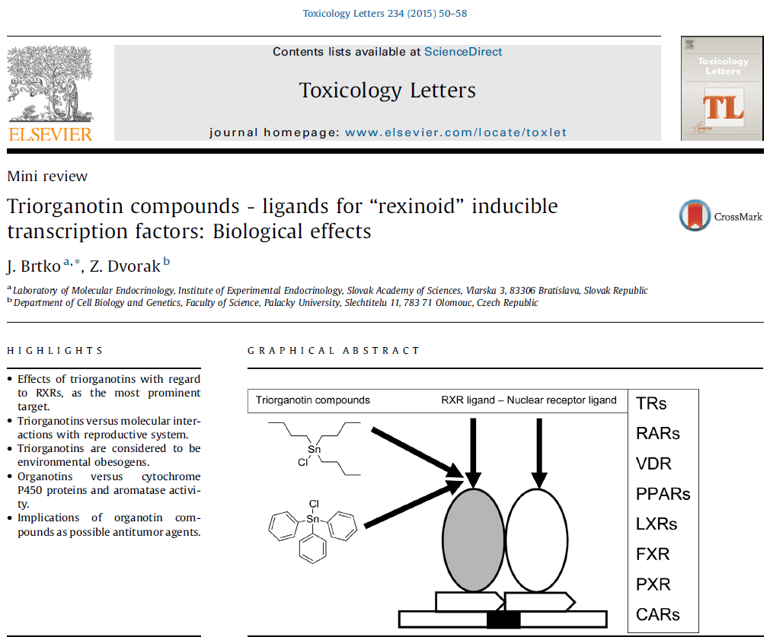
RETINOID X RECEPTOR - RXR

