Slide 1
WP4: Aurora Engaging Communities VR for Communication and Students Affairs

Slide 2
Motto:
Before we engage a community, we need to engage ourselves

Slide 3
Language
There is one word for a language and tongue in Czech

Slide 4
Work Package 4 is a substantive work package that will change educational practice so that students will be learning for demonstrable and tangible societal impact.
Notes:
The panel European Universities and UP - Strategy and Future, 9.30-10.30 am is meant to present the strategic relevance and opportunities in each of the divisions that you lead and discuss how education, research, sustainability, communication, and internationalization can both contribute to and benefit from the Aurora Alliance programme.

Slide 5
UP Strategy and Aurora Engaging Communities (WP4)
4.1 - Aurora Co-creation Practice
Goal 1: Flexible study and education
Goal 6: Systematization of third role tools
4.2 - Aurora Academic Collaboration
Goal 3: Excellence in research and development
Goal 5: Reduce administrative burdens and optimize infrastructure
4.3 - Social Entrepreneurship & Innovation
Goal 1: Flexible study and education
Goal 6: Systematization of third role tools
4.4 - Aurora Capacity Development Support programme
Goal 5: Reduce administrative burdens and optimize infrastructure
Goal 8: Internationalization in a globalized worl d
Goal 9: Strategic Partnerships
4.5 - Aurora Institute
Goal 1: Flexible study and education
Goal 5: Reduce administrative burdens and optimize infrastructure
Goal 6: Systematization of third role tools
Goal 9: Strategic Partnerships

Slide 6
Communication pitfals (Aurora Speed Dating)
Hi I am Mrs Aurora
Hi I am Mr Palacký
I want to work with you
What for?
To become engaged, harmonized and internatio-nalized
It sounds pretty unsexy to me..
Show me sth concrete

Slide 7
There is one word for „beton“ and „konkrétní“ in English

Slide 8
Task 4.1 Aurora Co-creation
This task aims to make co-creation a generally accepted embedded practice with academics skilled in co-creation as a technique.
Task 4.2 Aurora Research Platforms
Task 4.2 is concerned with developing academic collaboration within Aurora towards the intra-Alliance optimum, enhancing cross-fertilization between education and research.
Task 4.3 Social Entrepreneurship & Innovation
Focused on Social Entrepreneurship & Innovation, this task team strived to turn this concept into a common field of expertise at the Alliance level.
Task 4.4 Aurora Capacity Development Support program
The CDS Program, led by UP, aims to narrow the gap in quality in higher education & research by supporting universities in CE Europe and neighboring Countries in strengthening their capacity for academic excellence and societal relevance.
Task 4.5 Aurora Institute
This Task Team aims to form an Aurora Institute, to express and enhance the identity of the Aurora European University Alliance as a European institution in its own right, beyond the identity of the individual member universities of the Alliance.

Slide 9
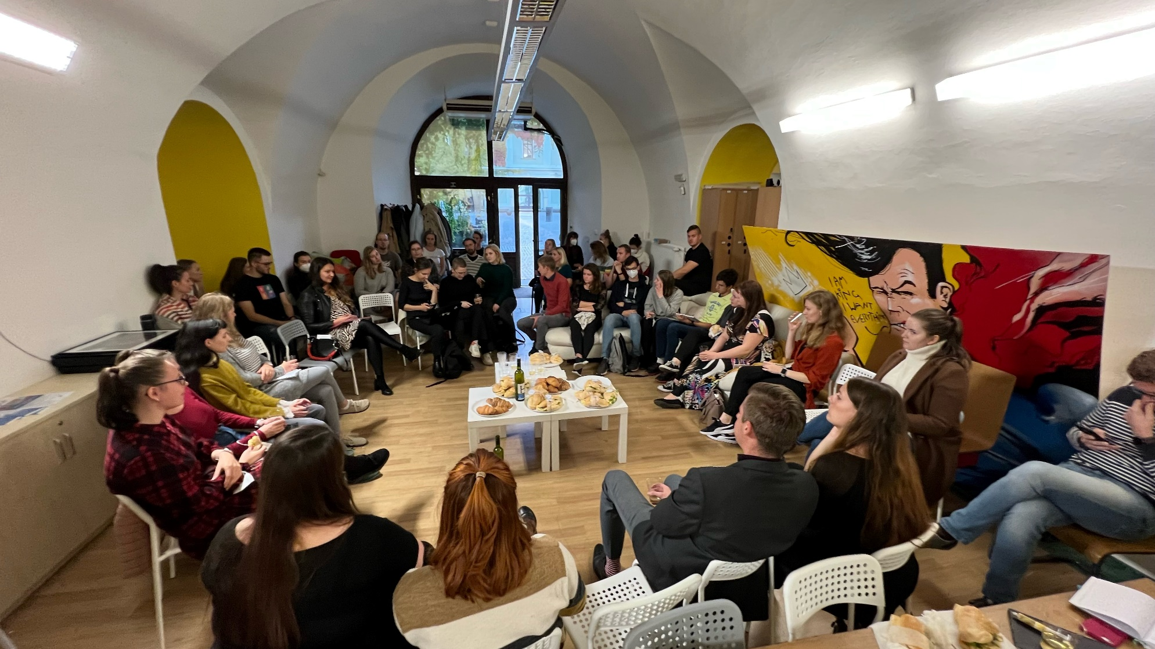
Task 4.1 Aurora Co-creation
This task aims to make co-creation a generally accepted embedded practice with academics skilled in co-creation as a technique.
Bottom up
Student as a partner
Talentovaný Palacký concept
Young teachers / PhD students coop
UPcrowd
Vědátor

Slide 10
Task 4.2 Aurora Research Platforms
Task 4.2 is concerned with developing academic collaboration within Aurora towards the intra-Alliance optimum, enhancing cross-fertilization between education and research.

Slide 11
Festival + Student Engagement = Wonders
More then 300 students participating
We don´t set barriers
We trust students
We give them opportunity
We give students responsibility students get very early on responsible positions under different levels of supervision
AFO production is incorporated to some studying programmes media and film studies; we are now including programmes at 3rd Age Universtity, engaging with seniors at all levels of produciton
Carrer and life experience (+ cost effectivness) We don´t do unpaid internships; we try to support student also financially. On the other side, high motivation and energy input by students result in lower production costs. Similarly sized festivals in Czechia have 2 -5 times higher production costs.
Task 4.3 Social Entrepreneurship & Innovation
Focused on Social Entrepreneurship & Innovation, this task team strived to turn this concept into a common field of expertise at the Alliance level.

Slide 12
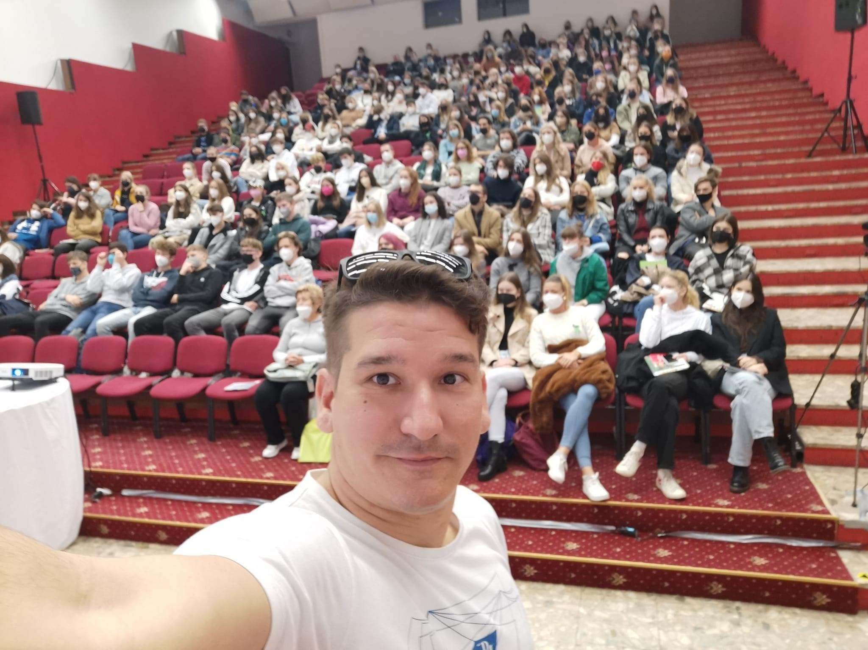
Task 4.4 Aurora Capacity Development Support program
The CDS Program, led by UP, aims to narrow the gap in quality in higher education & research by supporting universities in CE Europe and neighboring Countries in strengthening their capacity for academic excellence and societal relevance.

Slide 13
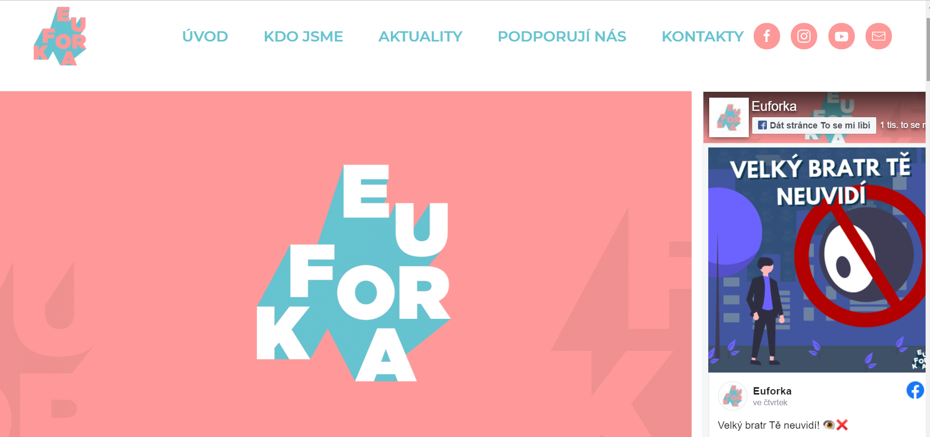
Task 4.5 Aurora Institute
This Task Team aims to form an Aurora Institute, to express and enhance the identity of the Aurora European University Alliance as a European institution in its own right, beyond the identity of the individual member universities of the Alliance.

Slide 14
Strategické priority a cíle Univerzity Palackého 2021+
Cíl 1: Flexibilní studium a vzdělávání
1.1 Vznik a rozvoj Centra excelence ve vzdělávání (CEV)
1.1.1 Podpora flexibilních forem studia a celoživotního vzdělávání
1.1.2 Podpora výukových kompetencí akademických pracovníků a dalších zaměstnanců UP
1.1.3 Podpora kurikulárního designu a hodnocení studijních programů
1.1.4 Podpora praxí a stáží
1.2 Vznik a rozvoj Studentského centra (SC)
1.2.1 Podpora uchazečů
1.2.2 Podpora studentských aktivit a spolků
1.2.3 Podpora služeb pro studenty se specifickými potřebami, mimořádně nadané a socioekonomicky znevýhodněné studenty
1.2.4 Podpora služeb pro studenty-rodiče
1.2.5 Podpora kariérního poradenství
1.2.6 Podpora absolventů
1.3 Internacionalizace ve vzdělávání
1.4 Systematizace evaluací vzdělávací činnosti
1.5 Monitoring reálných možností uplatnění absolventů
1.6 Podpora programu Absolvent
1.7 Efektivní komunikace nabídky vzdělávání
1.8 Rozvoj IT infrastruktury pro vzdělávání
Strategické priority AURORA Alliance: WP4
Learning for Societal Impact
4.1 Aurora Co-creation
4.2 Aurora Research Platforms
4.3 Social Entrepreneurship & Innovation
4.4 Aurora Capacity Development Support program
Task 4.5 Aurora Institute
Notes:
Pror. Procházka:
1.2.2 Podpora studentských aktivit a spolků
Návaznost na operační cíl SZ MŠMT 2021+: 1.C, 1.E, 2.G, II.3
Alokovaná finanční částka z PROPOST: 2.050.000 Kč
1.2.4 Podpora služeb pro studenty-rodiče
Návaznost na operační cíl SZ MŠMT 2021+: 2.C, 2.D
Alokovaná finanční částka z PROPOST: 1.000.000 Kč
1.2.5 Podpora kariérního poradenství
Návaznost na operační cíl SZ MŠMT 2021+: 1.C, 2.G, II.1, II.2
Alokovaná finanční částka z PROPOST: 6.849.684 Kč
1.2.6 Podpora absolventů
Návaznost na operační cíl SZ MŠMT 2021+: 2.G, II.1
Alokovaná finanční částka z PROPOST: 1.100.000 Kč
1.6 Podpora programu Absolvent
Návaznost na operační cíl SZ MŠMT 2021+: 1.C
Alokovaná finanční částka z PROPOST: 1.000.000 Kč
1.7 Efektivní komunikace nabídky vzdělávání
Návaznost na operační cíl SZ MŠMT 2021+: 2.B, II.1
Alokovaná finanční částka z PROPOST: 9.150.000 Kč

Slide 15
Finding common ground: integrate + spare
VR1
WP1
VR2
WP2
UP strategic plan 2021+
UP subplan for 2022
VR3
Aurora Goals
2021+
WP3
VR4
Propost funding for 2022
WP4
VR5
WP5
VR6
WP6
VR7
VR8

Slide 16
How to boost Aurorization at a Palacký
Agendas are largely overlapping: VRs need to copperate closely
Be infromed: every VR needs to have his Aurora deputy
Be prepared: is ti useful to have talking points in advance
Integreate Aurora things in a routine decision making
Speek Eglish, write English, publish English, think English!
We need to get an Aurora DNA into our daily life (and vice versa)

Slide 17
Aurora
students
UP

