Slide 1



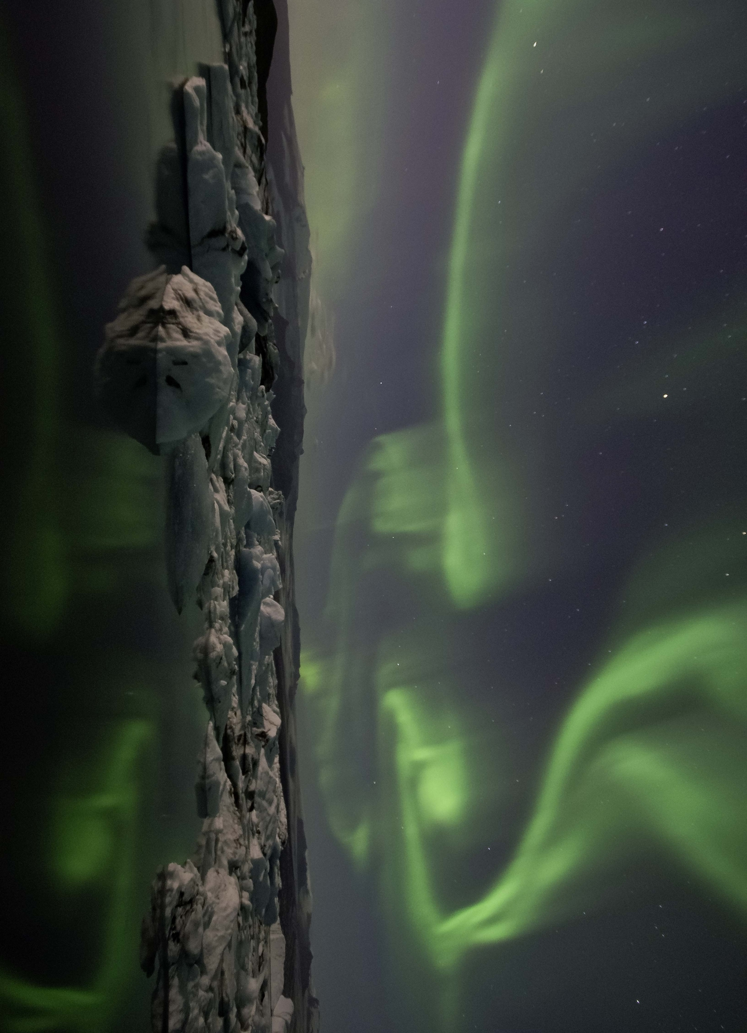
Welcome to Aurora Open Day
October 18th, 2021
Small Auditorium, Faculty of Education

Slide 2
Aurora European Universities
UP Open Day
Selma Porobić, PhD
Aurora Institutional Coordinator, Aurora Office, Rectorate

Slide 3
Presentation Overview
European Universities (EUN)
Aurora European Universities Alliance (AEUN)
Aurora Office and Coordination at UP
Information for Faculties & Faculty Visits

Slide 4

Objectives of the European Universities 2025-2030
European Universities – A flagship programme of EU’s HEA
European Universities 2018-2019 Pilot Calls
A more united and stronger Europe with…
…increase in quality, performance and competitiveness of European higher education institutions
Notes:
ALONG WITH MUTUAL RECOGNITION OF DIPLOMAS AND EU STUDENT CARD

Slide 5
How European Universities will look like in 2025-2030?
European curriculum customised by each student leading to a European degree
Innovative curricula with innovative pedagogies + embedded structured student mobility
Enhanced staff mobility between the partner institutions to teach/do research/work
A European Campus
Bachelor/Master/Doctoral levels

Slide 6
EUN is a very ambitious deeper level of collaboration:
Joint governance model
Shared, integrated, long-term strategic vision on education/research/innovation
European Statute
Notes:
European Universities’ have an ambitious mandate to trigger unprecedented levels of institutionalised cooperation between higher education institutions, making it systemic, structural and sustainable.
More specifically 'European Universities' aim to establish:
A shared, integrated, long-term joint strategy for education with, links to research and innovation and society at large
A European higher education inter-university ‘campus‘ offering curricula where students, doctoral candidates and staff can experience mobility at all study levels
European knowledge-creating teams addressing together societal challenges in a multi-disciplinary approach.
‘European Universities’ should act as models of good practice to further increase the quality, international competitiveness and attractiveness of European higher education. The action supports higher education institutions in going beyond existing higher education cooperation models, and gradually achieving the long-term ambitious vision for 'European Universities'.

Slide 7
Member Universities
AURORA Alliance
Who we are
07

Slide 8



UNITING
UNITING
What is Aurora EUN about?
30.000
Staff
260.000
Students
A partnership of like-minded
closely collaborating
research-intensive universities
673.922
Allumni
112
Faculties
813
Research
Groups
Notes:
Basic content slide + presentation boxes variant 1

Slide 9


Our goals:
Matching excellence with relevance
High trust platform: learning from & with each other
Equip graduates with entrepreneurial skills & mindset
As a partnership of European universities, we believe that we have a key contribution to make to the prosperity and wellbeing of our continent and the wider world. To achieve this, we serve communities and work with partners at a local, regional, European, and global level.
Notes:
Aurora is a partnership of like-minded and closely collaborating research-intensive European universities.
We have a history of engagement with our local communities and are wholly committed to ensuring beneficial social impact in our activities and to the achievement of the sustainable development goals. Aurora’s vision is to use the academic excellence of our members to drive societal change through research and education, delivering our motto of “matching academic excellence with societal relevance”. Our vision will be achieved through the strategic priorities of: diversity & inclusion, societal relevance & impact of research, student engagement, and innovation in teaching & learning.
We operate as a high trust platform; we want to learn with and from each other by sharing our expertise, resources, strengths but also challenges. Aurora is built upon meaningful collaboration and synergies within and between the partners at all levels - leaders, academics, administrators and students.
Our shared educational philosophy is to equip our graduates with the skills and mindset needed to tackle society’s problems in a socially entrepreneurial and innovative way.
As a partnership of European universities, we believe that we have a key contribution to make to the prosperity and wellbeing of our continent and the wider world. To achieve this, we serve communities and work with partners at a local, regional, European, and global level.

Slide 10
Legal framework of our collaboration
Aurora EUN Grant Agreement with European Commission – 2020/2023
Aurora EUN Consortia Agreement – 2020/2023
Aurora Horizon 2020 SWAFs Agreement with European Commission 2021/2024
Aurora Consortia Agreement Research and Innovation 2021/2024 TBS
Multilateral Aurora Mobility Agreement 2021-2023 TBS
Number of Guiding Documents: Quality Management Plan, Financial Guidelines, Risk Management Plan, Sustainability Action Plan, Aurorisation/Internaitonalsaiton Competence Framework ...

Slide 11
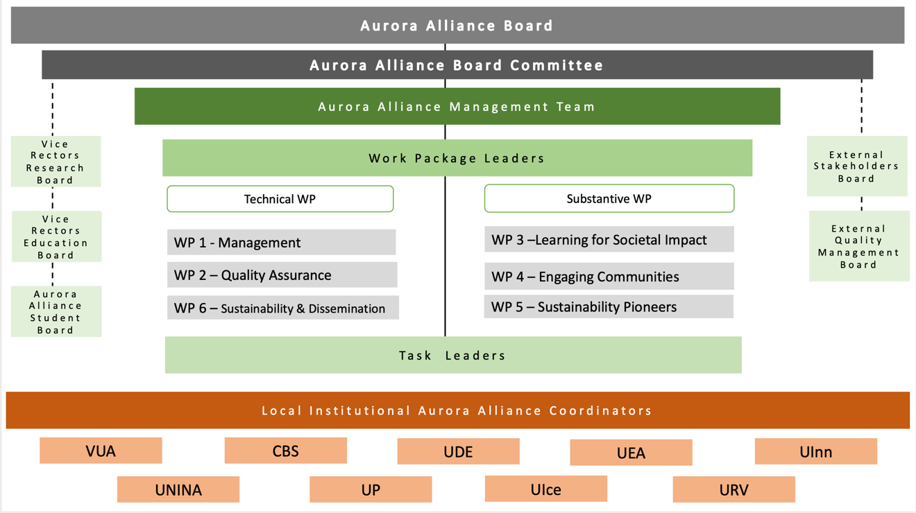
AURORA Governance Structure

Slide 12

UNITING
Learning for societal impact
The Aurora Activity Programme
Engaging communities
Shared priorities
The activity programme set out in our European University Initiative is the shared ambition and endeavour of our students, academics, university leaders, and administrators.
It reflects the Aurora vision of a European University in four pillars
Sustainability pioneers
Research &
Innovation for
Societal impact
Notes:
The overall vision of Aurora universities is to maximise the positive social impact of our teaching, learning and training activities. This is achieved by integrating innovative teaching methods and approaches together into our existing study degree programmes that are designed to better equip our graduates with the necessary skills, competencies and mindset to address societal challenges as social entrepreneurs and innovators in a fast-changing world. Four Pilot Domains1 and the Sustainable Development Goals (SDGs) provide the thematic bracket for this, which also reflects the research strengths of the Aurora universities.
The activity programme set out in our bid is the shared ambition and endeavour of our students, academics, university leaders, and administrators and reflects the Aurora vision of a European University in four pillars:
Aurora Learning for Societal Impact aims to equip students and graduates with the skills and mindset needed for them to take responsibility and initiative in addressing societal challenges.
Aurora Engaging Communities is about engagement with our diverse stakeholders at local, regional, national, European, and global level, as well as with our students and academics.
Aurora Sustainability Pioneers aims to make our universities as sustainable as possible across all their endeavours.
Aurora Research and Innovation for Societal Impact aims to deepen and expand our cooperation as research-intensive universities dedicated to societal impact and engagement within the framework of the SDGs.

Slide 13
How we work - 6 Work packages & 26 Activities
WP 1 Management & Leadership
WP 3 Learning for Societal impact
WP 4 Aurora Engaging Communities
UP Co-lead
WP 2 Quality Assurance
Task 3.1 Aurora Competences Framework
Task 4.1 Co-creation
Task 1.1 Governance
Task 2.1 Quality Systems
WP 5 Aurora Sustainability Pioneers
Task 3.2 Aurora Social Transformation
Task 1.2 Communications
Task 2.2 Quality Culture
Task 4.2 Research Platforms
WP 6 Sustainability & Dissemination
Task 5.1 Aurora SDG Research Dashboard
UP Co-lead
Task 3.3 Aurora Borderless Learning
Task 1.3 Monitoring
Task 2.3 Internal Quality Monitoring
Task 4.3 Social Entrepreneurship & Innovation
Task 3.4 Aurora Pilot Domains Coordination
Task 5.2 Aurora Sustainability Education
Task 6.1 Sustainability of the Aurora Alliance programme
Task 2.4 External Quality Monitoring
Task 4.4 Aurora Capacity Development Support programme
Task 1.4 Financial Management
Task 3.5 Aurora Teaching for Societal Impact
Task 5.3 Aurora Sustainable Campus
Action plan ASCA
Task 6.2 Dissemination
Task 1.5 Risk Management
Task 2.5 Quality Enhancement
Task 4.5 Aurora Institute
Task 3.6 Aurora Learning Analytics
013
How?

Slide 14
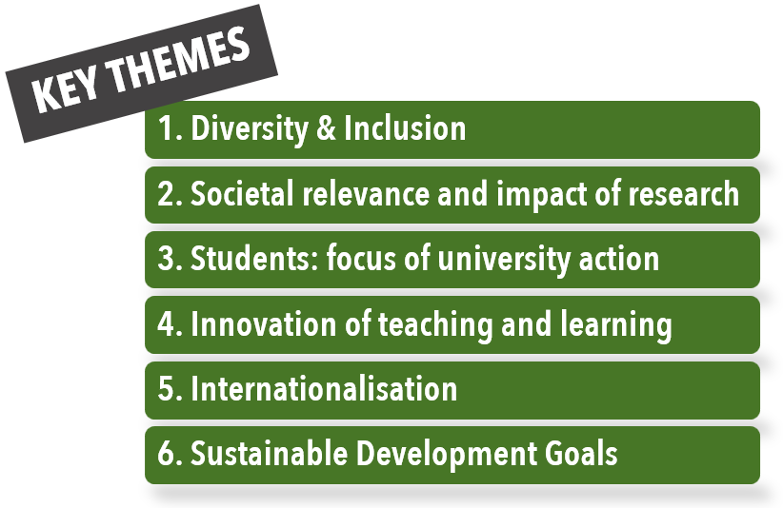

Aurora Alliance – Pilot Collaboration Areas

Slide 15
Meetings & frequent engagement
Management
WP3,4,5 & Activity teams
Aurora Board & Committee Meet quarterly
VRs Education and Research Meet bimonthly
ICs Meet monthly
WP 1,2,6 Meet Monthly
WP leads & co-leads with Team Leaders Meet monthly
Team Leaders and participants Meet 1-2 per month or more
Aurora programme Director and Team leaders Meet as often as needed

Slide 16

1
Quality Management Plan
100+
Local dissemination meetings /events
1
Training Plan
350+ Participants
30+
Task Teams
TT Meetings every 4-6 weeks
1 project tool
+
collaboration platforms
40+
News items
published
9
websites
7
Videos
List of Things
Notes:
Basic content slide

Slide 17

1 year Results: WP3 - Learning for Societal Impact
UNITING
Over 100 courses and 25 programs to be “Aurorarised”
41 summer school opened in 2020
5 Trainings for COIL + Internationalisation
1 mobility framework
9 mobility plans in the making
1 language course to open in Sept. for each
language represented in the Alliance
1 internship framework
1 Service-Learning course - 90 students
15 000 Open Educational Resources
gathered for inventory
1 common virtual campus in the making
1 local integration of Aurora in course catalogue
Reflexion towards automatic recognition
3 courses piloting the
Competence Framework approach
Notes:
Work Package “tree” list

Slide 18
Aurora Coordination at UP and Aurora Office
Integrated into UP Strategy 2021-2027 across all Strategic priority areas
Strategic Coordination under VR Strategy & External Relations
Shared ledership responsibility with International Division and VR Intenationalisation
Programme implementation 2020-2023 embedded in Education, Research, Communication, Sustainability and Internationalisaiton with corresponding VRs monitoring task teams
Collaboration with Project Service – Financial Managemnt
Aurora Mobility Working Group– IO Director, Eramsus Coordinator, Int Trainesheeps Coordinator, Admin officer

Slide 19
UP Organisational Management Chart

Slide 20
Work Packages – 26 people, 7 Schools
WP3: Aurora Learning for Societal Impact
Veronika Tomoszková, Max Tomosek | WP 3.1.1 Participant
Marie Raková | WP 3.1.2 Lead
Zuzana Hanelova | WP 3.1.2 Participant
Natasa Matulayová | WP 3.1.3 Participant
Lucia Madleňáková | WP 3.2 Participant
Yvona Vyhnankova | WP 3.3 and 3.3.1 participant
Markus Johan Öbrink | WP 3.3.2 Participant
David Skoupil | WP 3.3.3 Participant
Miroslav Syrovátka | WP 3.4 .1 Participant
Klára Seitlová | WP 3.4 .2 Participant
Petra Mandysova, Helena Kisvetrova | WP 3.4 .3 Participant
Vít Voženílek, Pavlina Flajsarova | WP 3.4 .4 Participant
Jana Poláchová Vašťatková | WP 3.5 Participant
Miroslav Dopita | WP 3.5 Participant
Vít Dočekal | WP 3.6 Participant
WP4: Aurora Engaging Communities
Veronika Glogarova | 4.1 Participant
Marie Jadrnickova | 4.2 Co-lead
Ondrej Krocil | 4.3 Participant
Tereza Kalouskova | 4.4 - Lead
WP5: Aurora Sustainability Pioneers
Robert Jaworek | 5.1 Participant
Jiri Tesarik | 5.2 Participant
Zuzana Hunakova | 5.3 Co-lead
Miroslav Syrovatka | 5.4 Participant

Slide 21
Aurora UP Office
Institutional Coordinator-- operational management of the project through the UP Aurora Office.
Executive Assistant & Communication Officer
Finance Manager
Administration and Internal Communications officer
Aurora Research & Innovation Coordinator and Research officer

Slide 22
What Aurora office can do for you
Provide info about Aurora events/collaborations and opportunities for your administration, academic staff and students
Match-make and help find short-term and long-term strategic education and research partners across Aurora universities
Provide opportunity to deepen strategic partnership in CEE and broader through Aurora Capacity Support Programme
Support enlargement of your study programmes through aurorisation /internationalisaiton of curricula and WP 3 programme
Support engagement with local stakeholders through WP 4 and engaging communities
Support environmental sustainability through Action plan in WP5

Slide 23
Upcoming Faculty Visits
Faculty of Health Sciences: 14.1. 2022 (9-11 am)
Faculty of Law: 14.1. 2022 (14-16 pm)
Faculty of Education: at the end of the winter semester (TBC)
Faculty of Theology: no response yet (TBC)
Medical Faculty: no response yet (TBC)
Faculty of Physical Culture: no response yet (TBC)
Faculty of Science: no response yet (TBC)
Faculty of Arts: no response yet (TBC)
Notes:
Alt main slide:
There are 2 layered images. To select bottom image and replace it, click on image, select “Picture Format” in ribbon, then “Select Pane” in “Arrange” tab. Select picture in the column on the right (Picture 4), move or right click, then “Change Picture”
Alternate font is used for the title – download the font file “right_click_on_me_and_select_install.otf” to your computer, right click on the downloaded file, select “Install”. After this, font should be available to use in any application (name of the font is Salome).
If you choose to do so, use “Salome” only on titles!

Slide 24


Aurora Website
UP Website
News Letter
Social Media
Learning &
Engaging communities
for Societal Impact
    https://aurora.upol.cz
CDS Training event
South-West University “Neofit Rilski”
October 5-6 2021
Enjoy the Open Day!
Notes:
Alt main slide:
There are 2 layered images. To select bottom image and replace it, click on image, select “Picture Format” in ribbon, then “Select Pane” in “Arrange” tab. Select picture in the column on the right (Picture 4), move or right click, then “Change Picture”
Alternate font is used for the title – download the font file “right_click_on_me_and_select_install.otf” to your computer, right click on the downloaded file, select “Install”. After this, font should be available to use in any application (name of the font is Salome).
If you choose to do so, use “Salome” only on titles!

